Slide 1
Ocean Surface Generation and Rendering
Thomas Gamper
Research Division of Computer Graphics
Institute of Visual Computing & Human-Centered Technology
TU Wien, Austria

Slide 2
Overview
Motivation
Wave spectra
Level of detail
Summary
Future Work

Slide 3
Motivation
Generating and rendering of believable ocean surfaces represents a permanent topic of interest in computer graphics
Wave simulation
Lighting

Slide 4
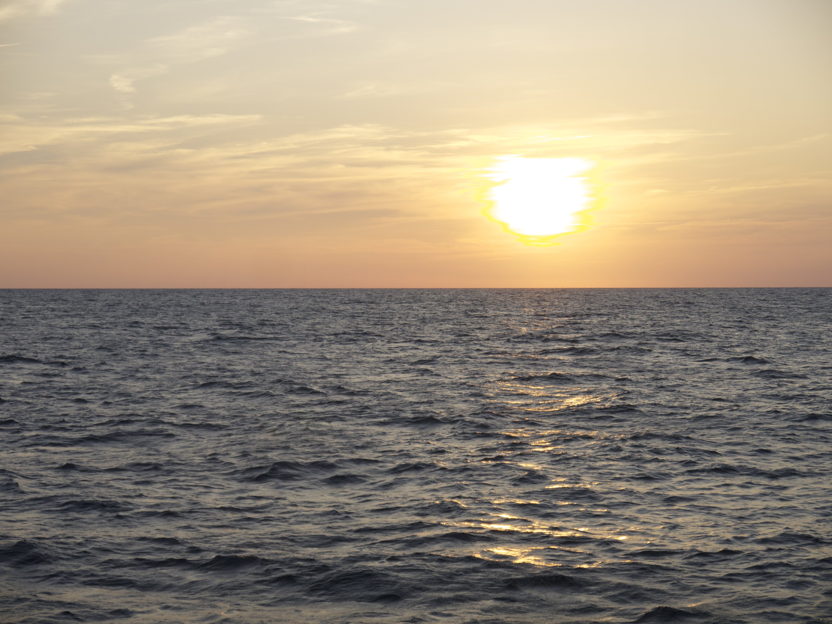
Motivation

Slide 5

Motivation

Slide 6
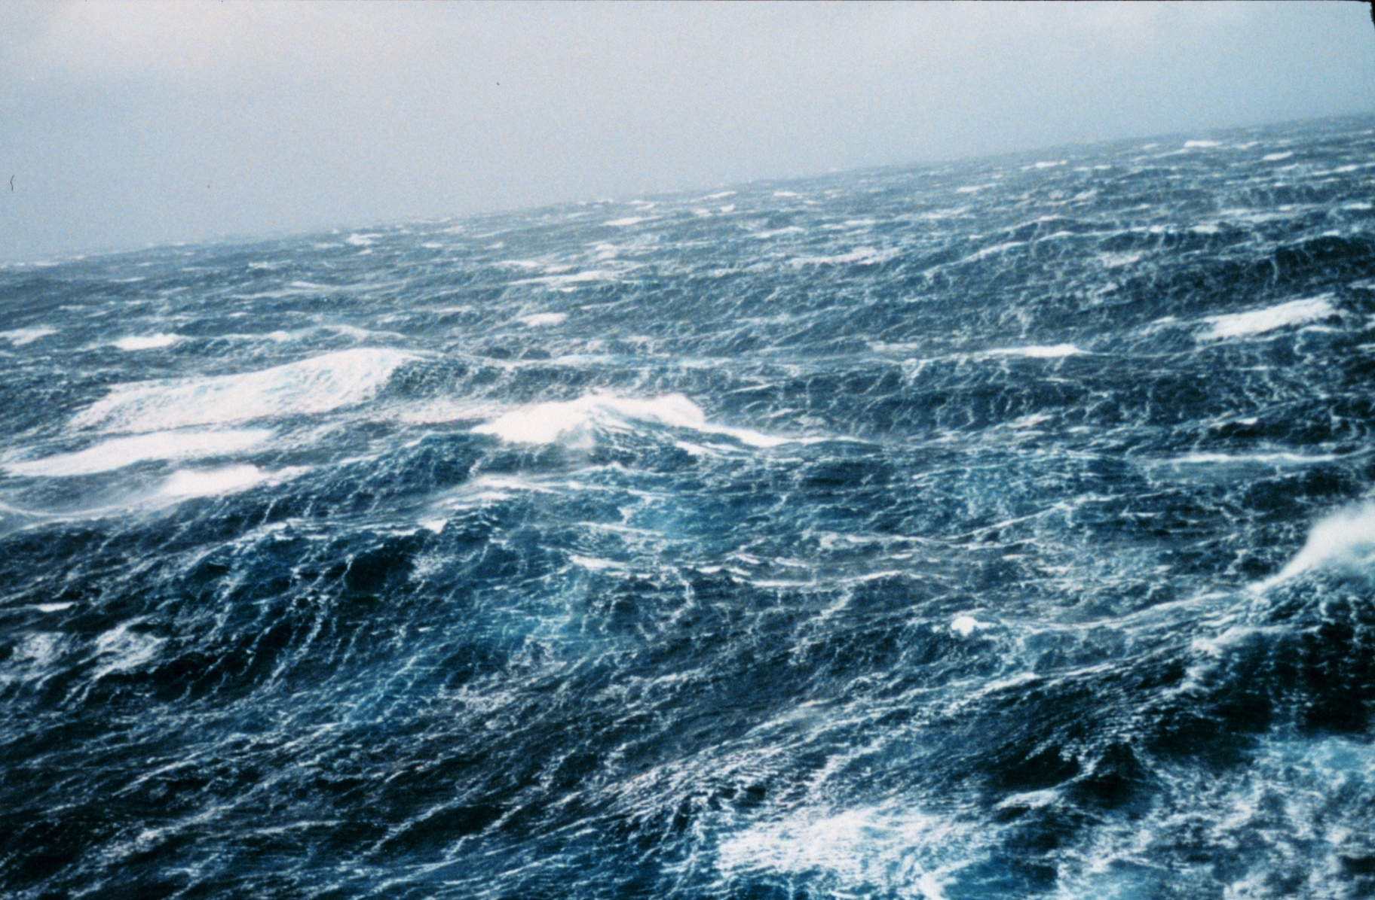
Motivation

Slide 7
Motivation
Ocean surface generation and rendering even more of a challenge in context of real-time rendering
Ocean is dynamic and complex
Closeups and views to horizon
Lighting

Slide 8
Related Work
Choppy wave algorithm [Tessendorf1999]
Employs wave spectrum concept from oceanographic reasearch
Horizontal and vertical displacements
First order partial derivatives for normals and whitecaps
Adapted for real-time operation
Meshing [Hinsinger2002, Johanson2004]
Lighting [Bruneton2010a, Bruneton2010b]
Whitecaps [Dupuy2012]

Slide 9
Problems
The wave spectrum
Many distinct models
Which model fits which type of sea best?
Which models are compatible with [Brunetone2010a, Bruneton2010b]
Performance
Level of detail

Slide 10
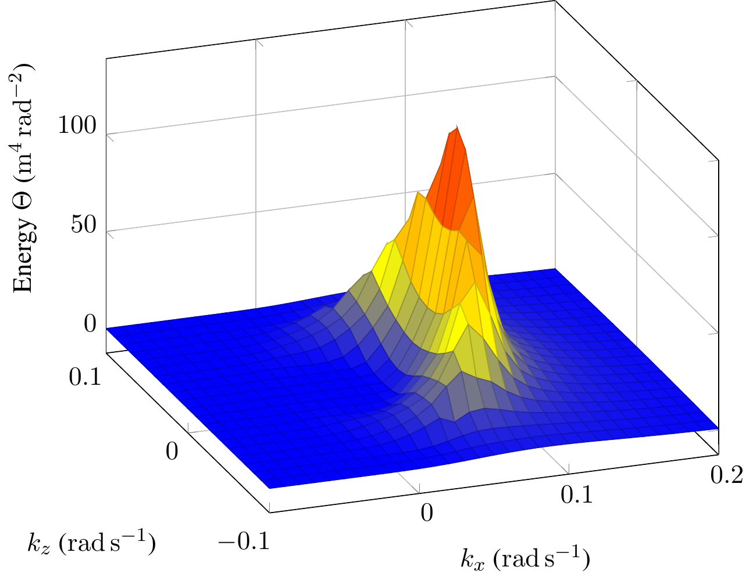
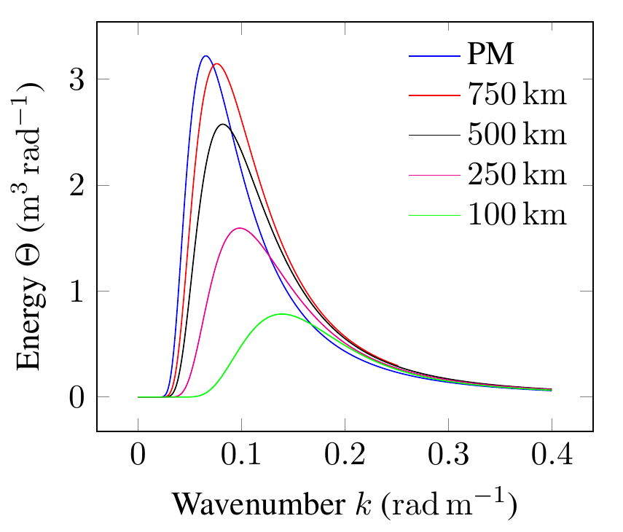

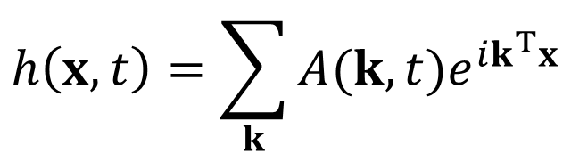
Wave spectrum
$$h\left(x,t\right)=\sum_{k}{A(k,t)e^{ik^{T}x}}$$

Slide 11
Evaluated wave spectra (1/2)
Pierson Moskowitz
Works best for gentle seas
Awesome with lighting
JONSWAP
Suitable for agitated seas
Works well with lighting, except low fetch conditions
Donelan
Suitable for all kinds of sea
Lighting is a disaster

Slide 12
Evaluated wave spectra (2/2)
Unified
For all seas between PM and JONSWAP
Good with small wavelengths -> closeups
Works flawlessly with lighting
Tessendorf
Geometry is a disaster, no further analysis

Slide 13
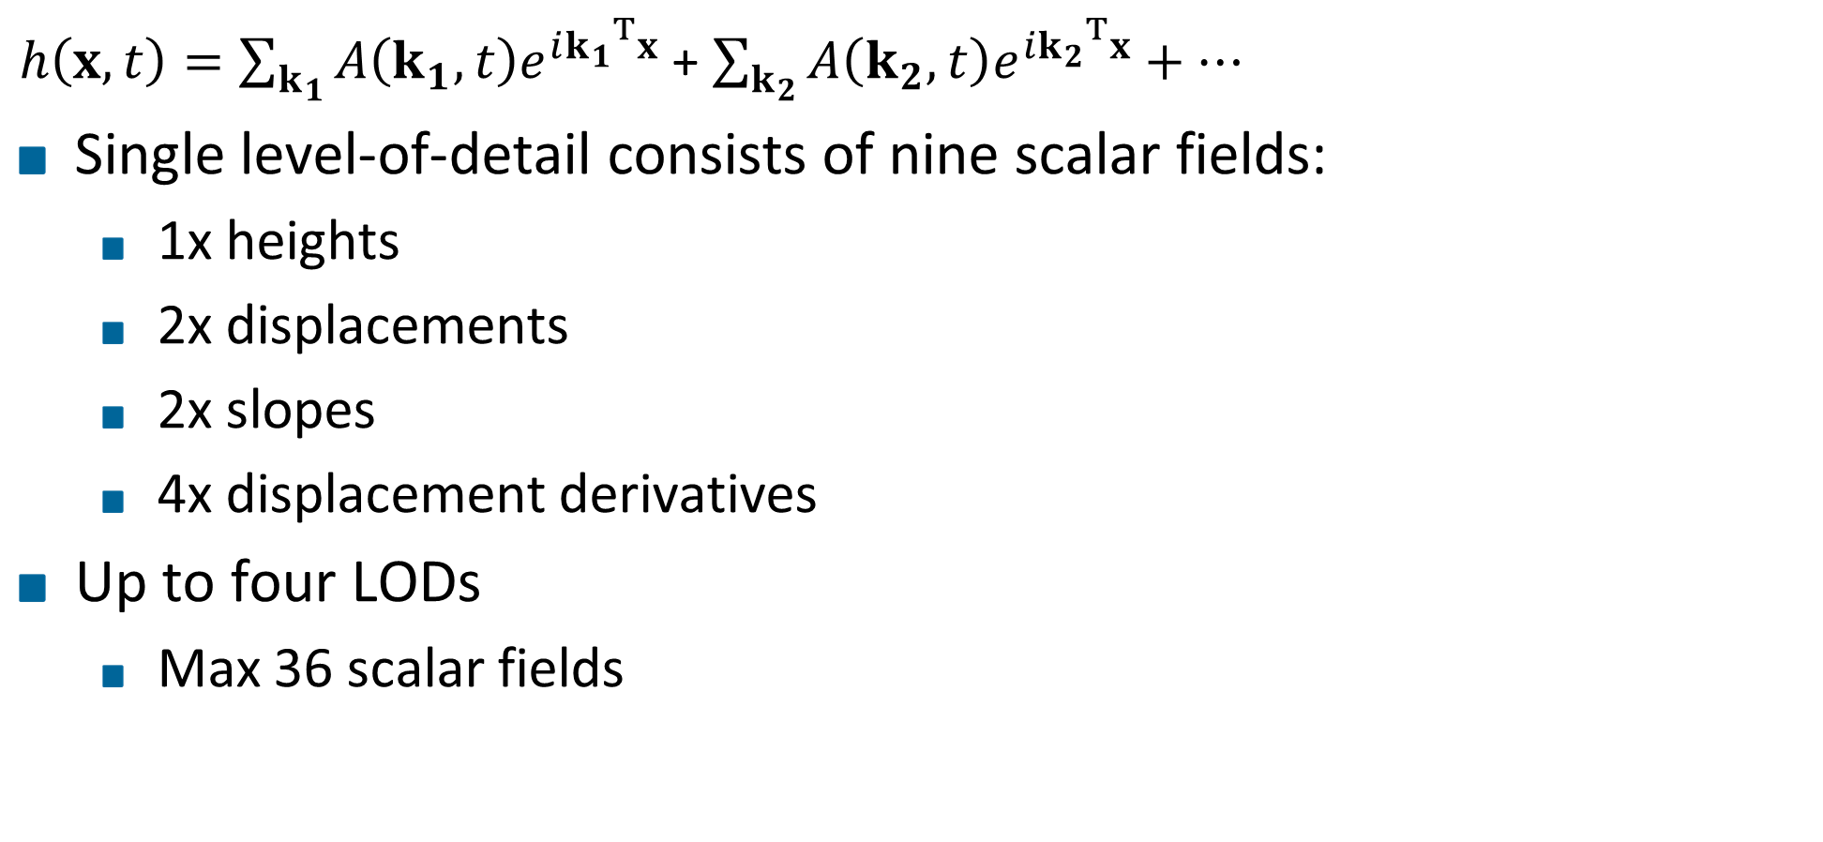
Level of detail
$h\left(x,t\right)=\sum_{k_{1}}{A\left(k_{1},t\right)e^{i{k_{1}}^{T}x}}$ + $\sum_{k_{2}}{A\left(k_{2},t\right)e^{i{k_{2}}^{T}x}}+…$
Single level-of-detail consists of nine scalar fields:
1x heights
2x displacements
2x slopes
4x displacement derivatives
Up to four LODs
Max 36 scalar fields

Slide 14
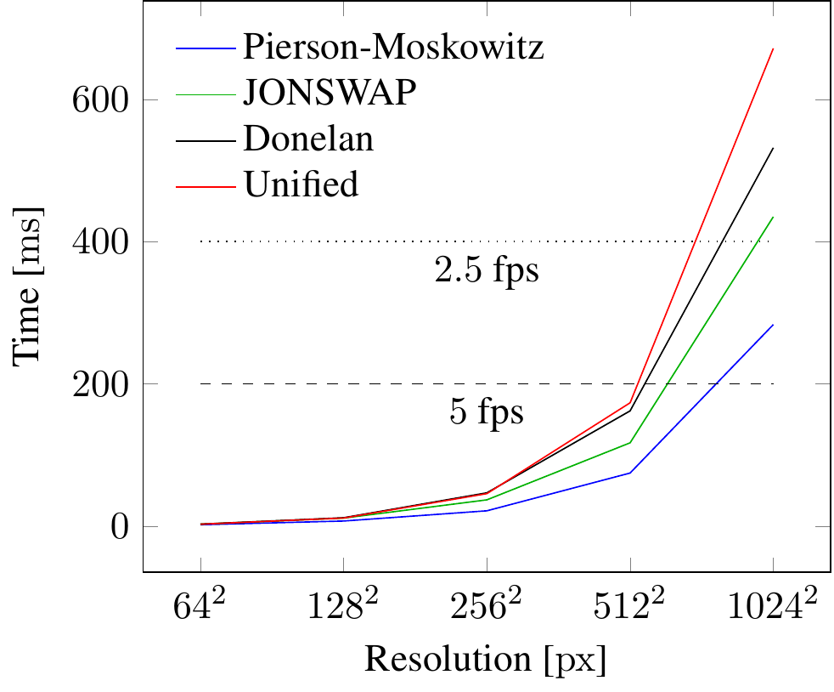
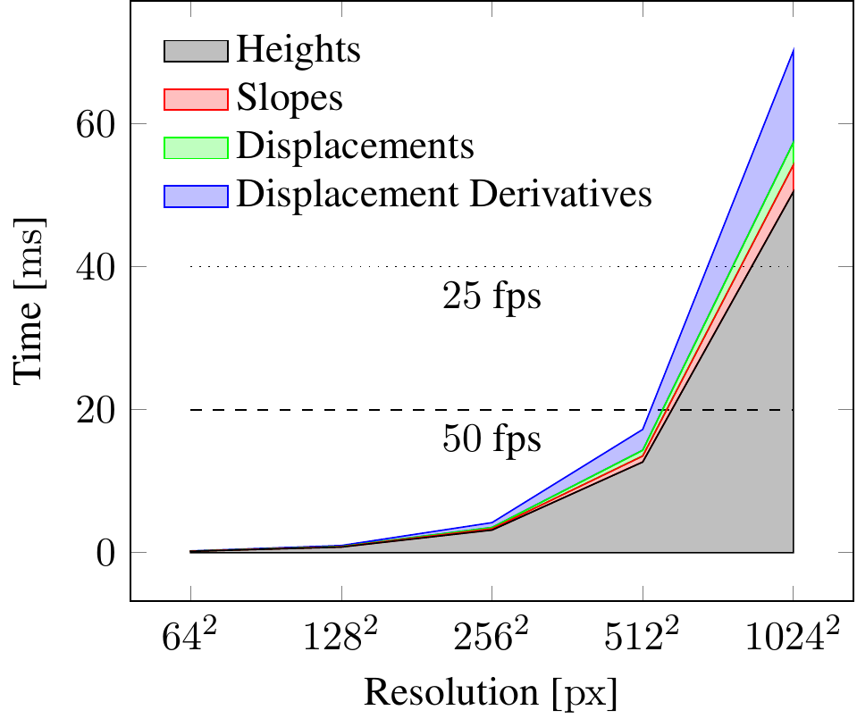
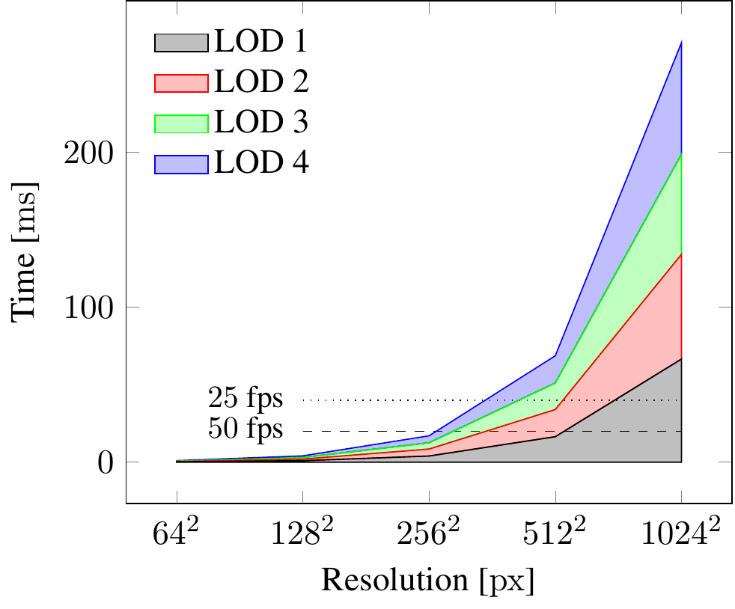
Performance LOD generation

Slide 15
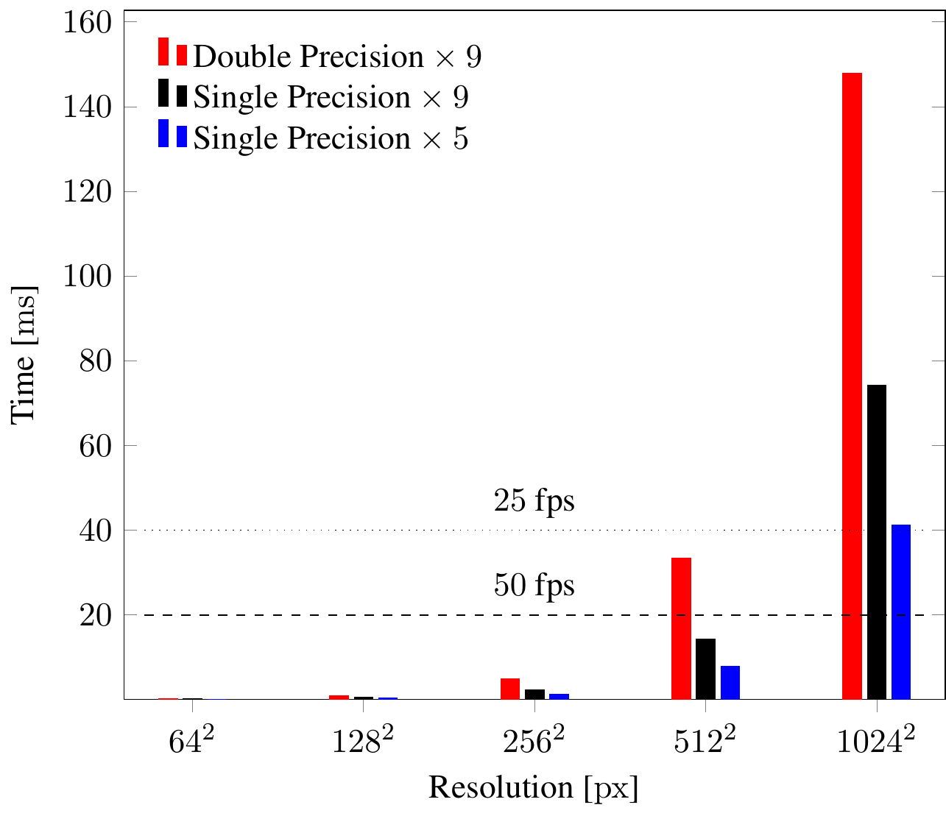
Performance FFT
Pack nine scalar fields into 5

Slide 16
Multi-Res
Support two distinct resolutions
Heights and displacements
Slopes and displacement derivatives
Only up to 10% gain for generation
Speedup in FFT up to 40% because low-res FFT basically negligible
Further improvements down the line because less data to transfer and to process

Slide 17
Summary
Contribution 1: implement and evaluate wave energy models
Pierson-Moskowitz and Unified work well in all conditions
JONSWAP works well in all conditions, except low-fetch
Donelan and Tessendorf disqualified
Contribution 2: multi-resolution level-of-detail
Allows for more fine-grained balance between model detail and performance

Slide 18
Thank You for your Attention!
Video!!!!!!

Slide 19
Future Work

Slide 20
Headline
Level 0
Level 1
Level 2
Hint: Do NOT use bullet lists wherever possible !!!

Slide 22
Sometimes a dark background is better. Use this template.

Slide 23
Thank You for your Attention!
Don't forget to include a last slide that contains teaser images or a video or something else that reminds people about what you said.
It might well be that this slide will be on the screen during the whole discussion!

